Slide 1
IT Internship Presentation
Mariah Moore

Slide 2

Projects
Harriman Quarry Internet
Colas ISS Conference
Cheyenne Airport Internet
Twilio
Power Automate
Reset password
Add Colas ID

Slide 3
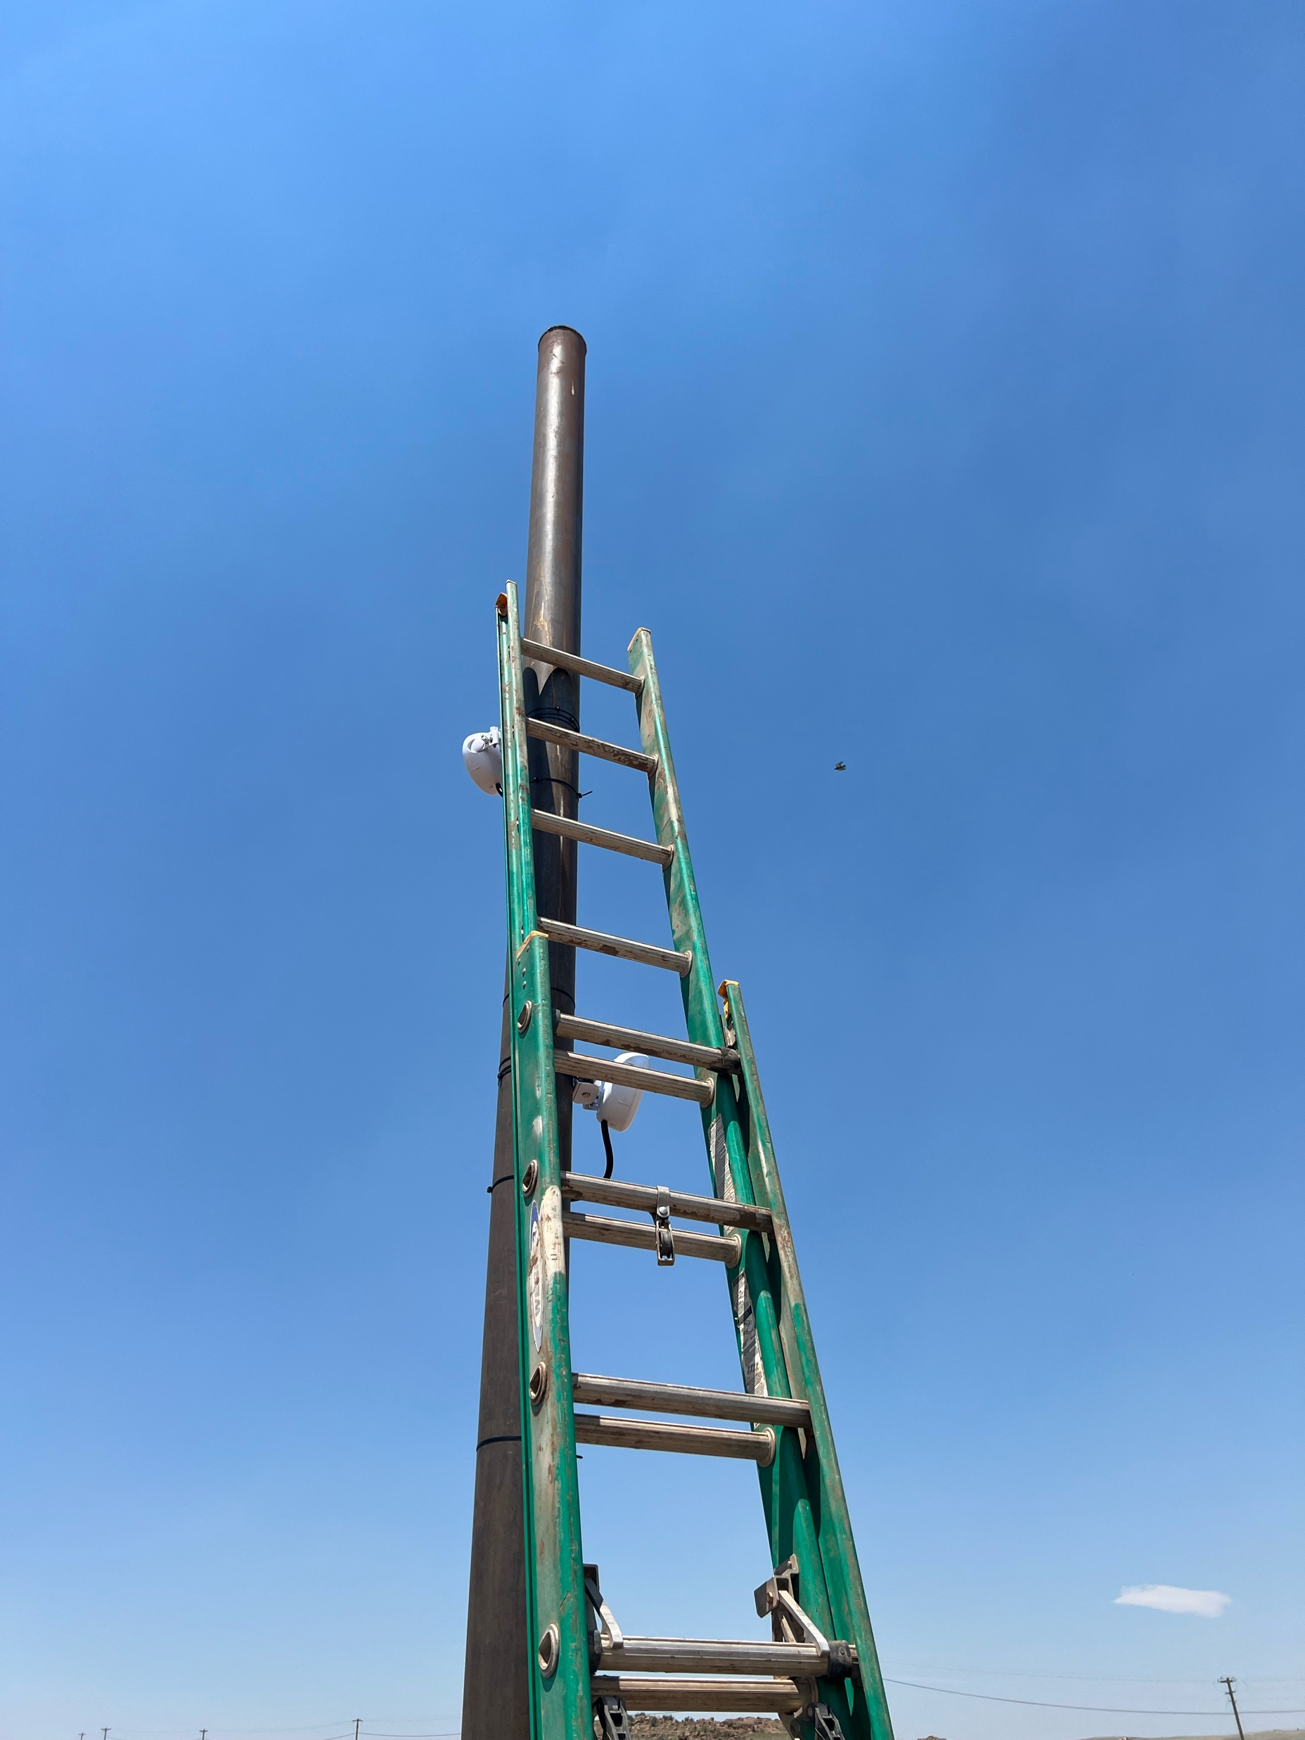
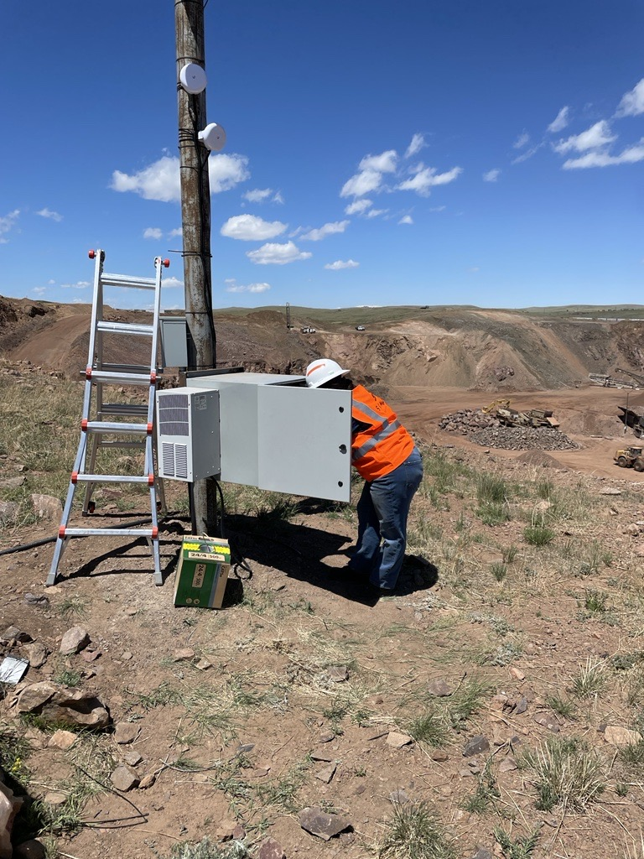
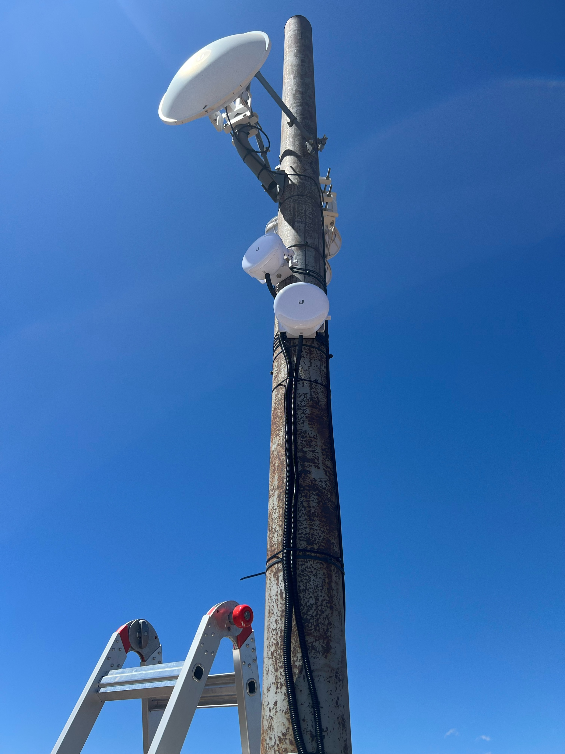
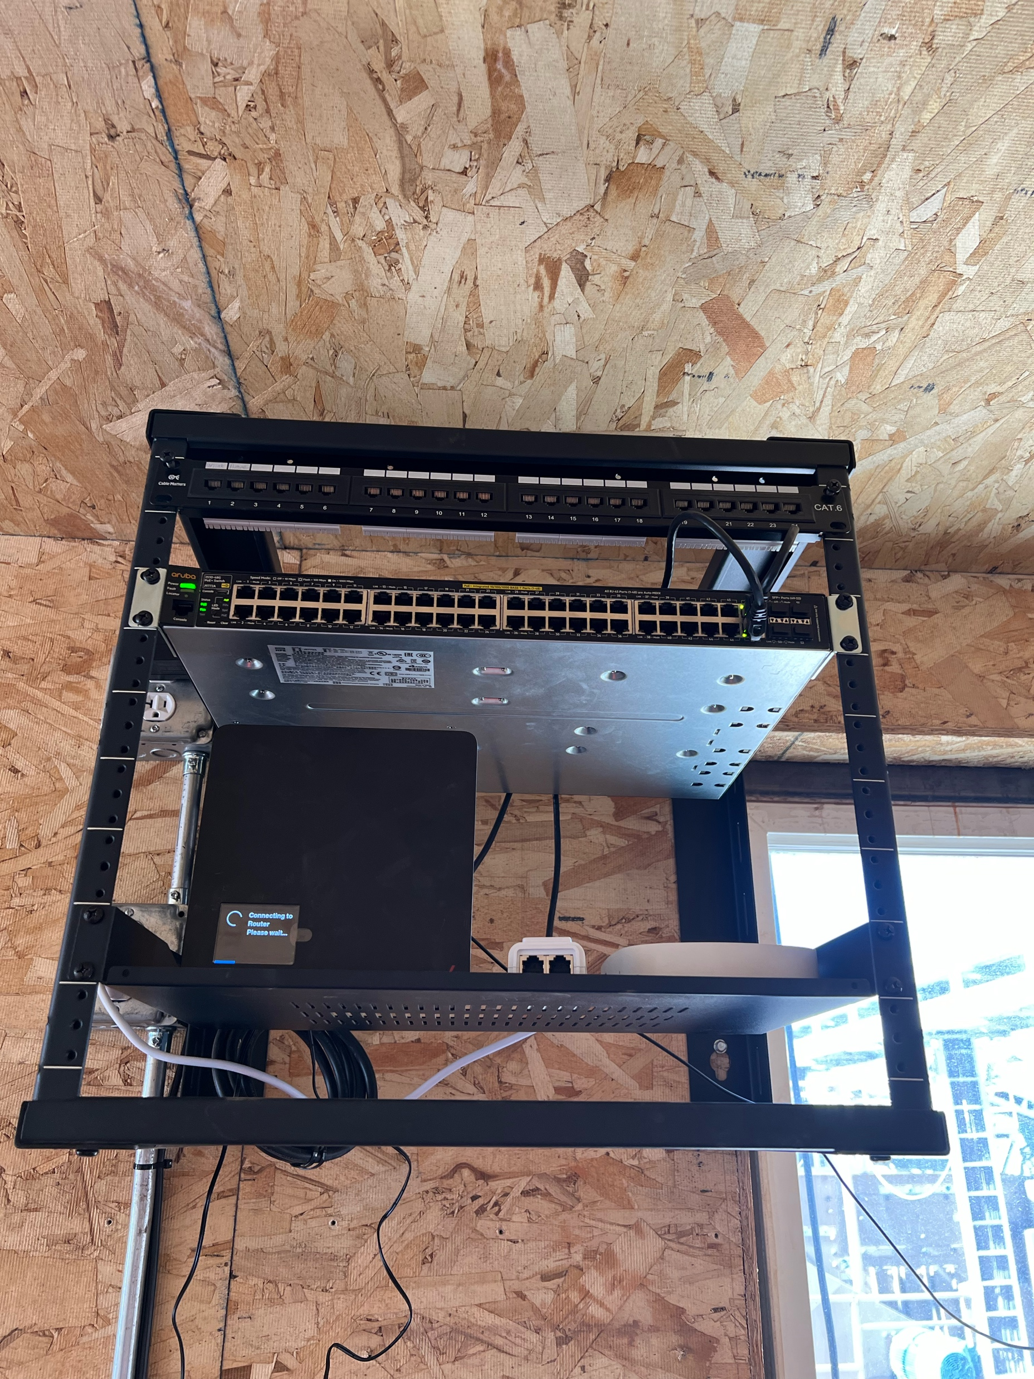
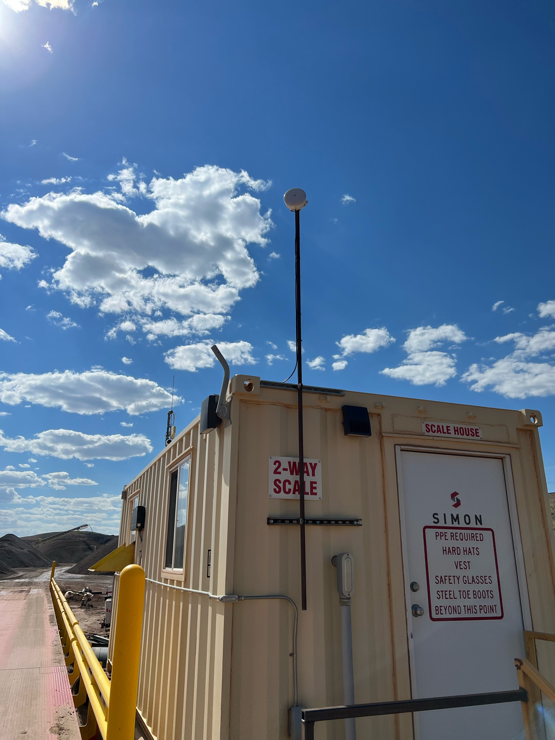
Harriman Quarry

Slide 4
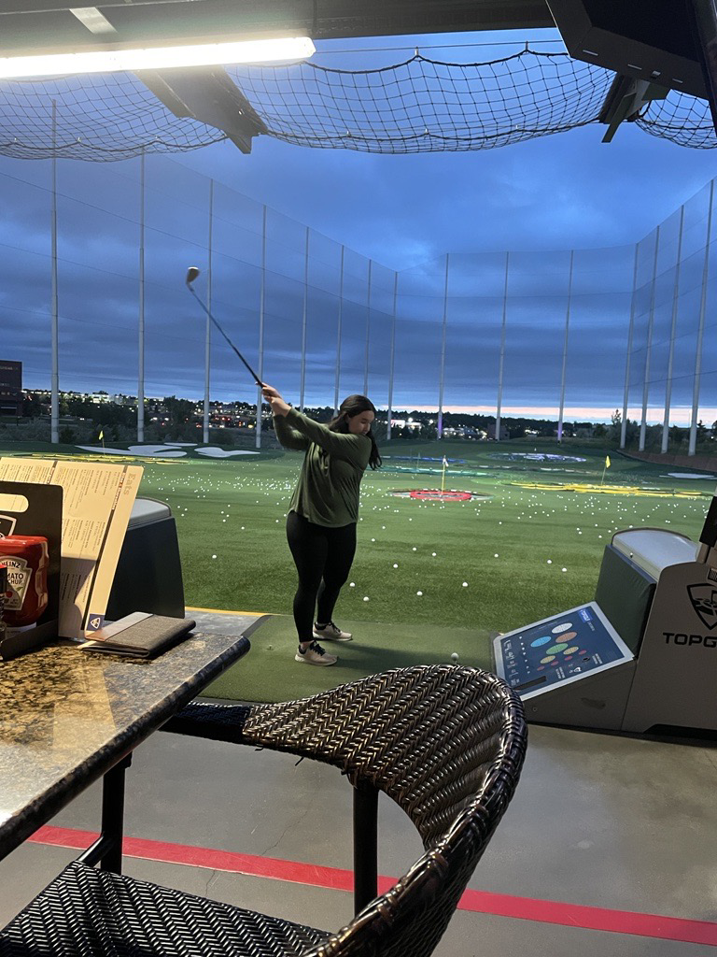
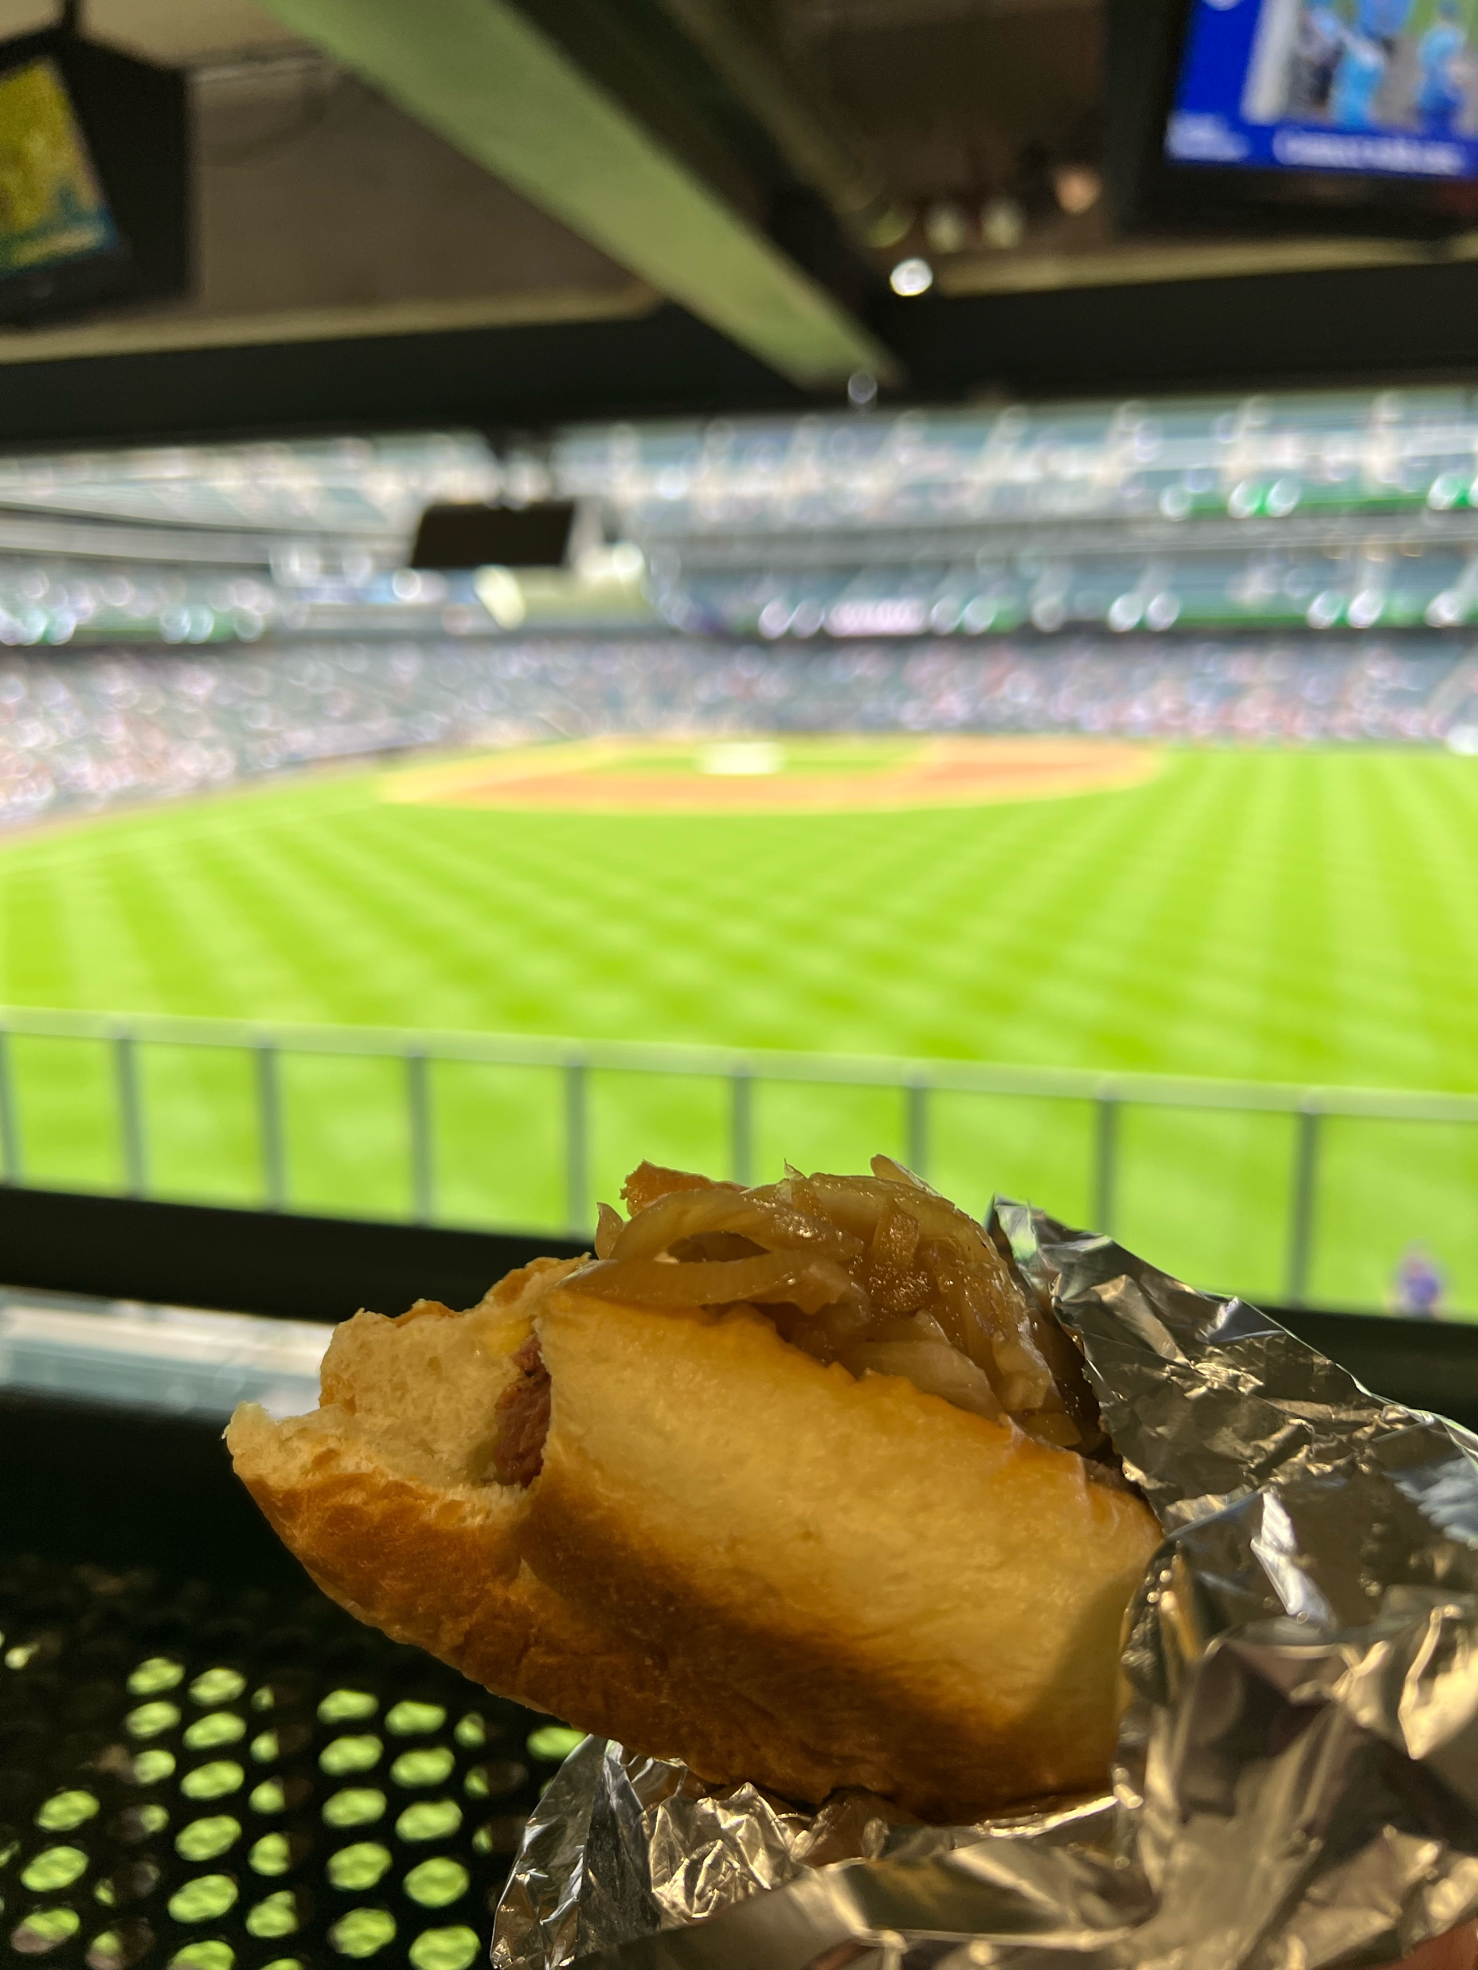
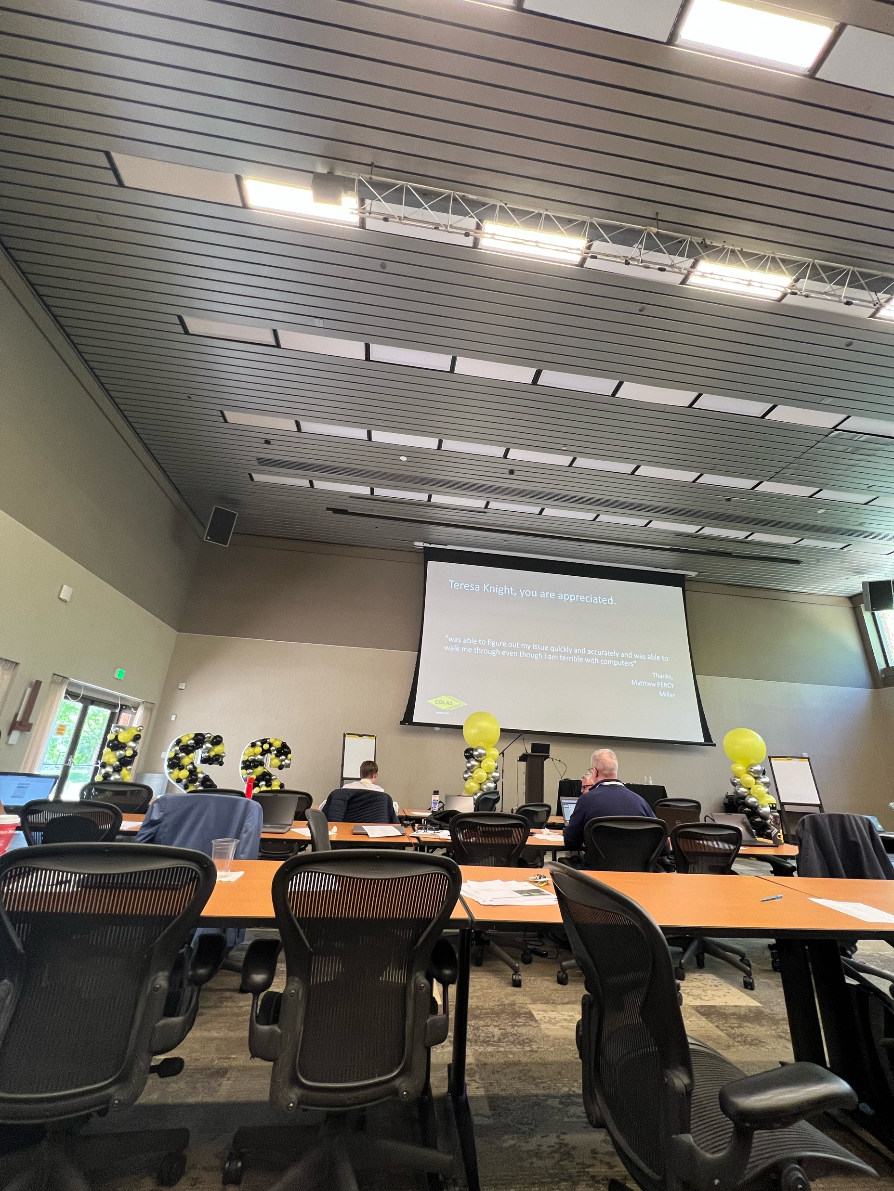
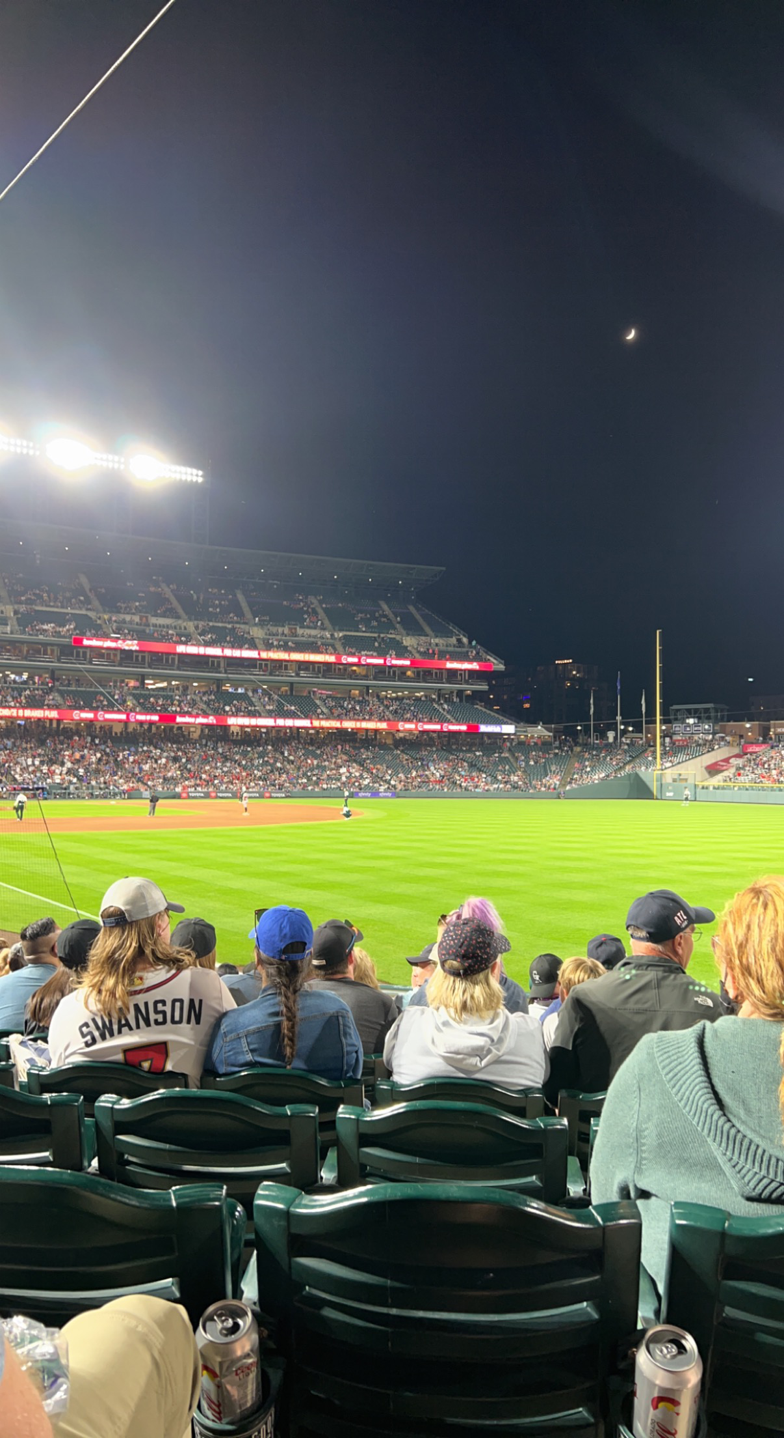
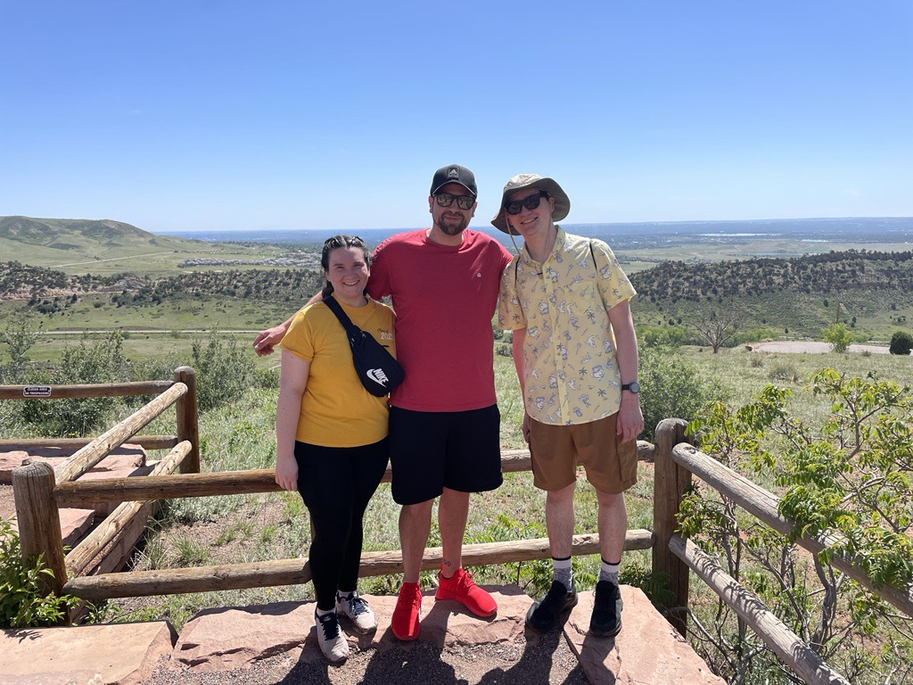
Colas ISS Conference

Slide 5
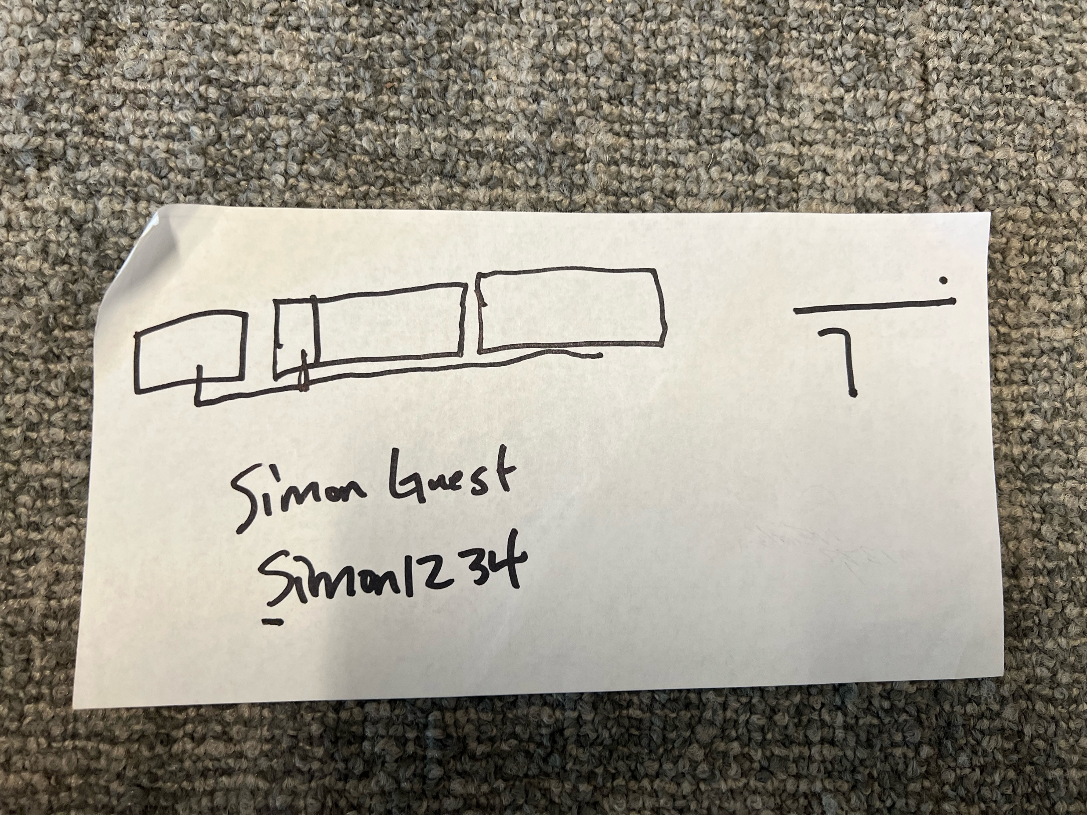
Cheyenne Airport

Slide 6
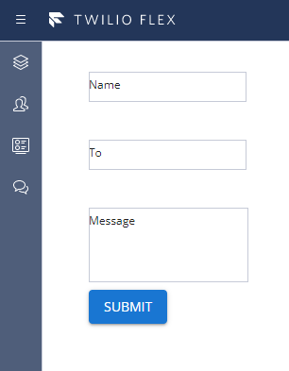
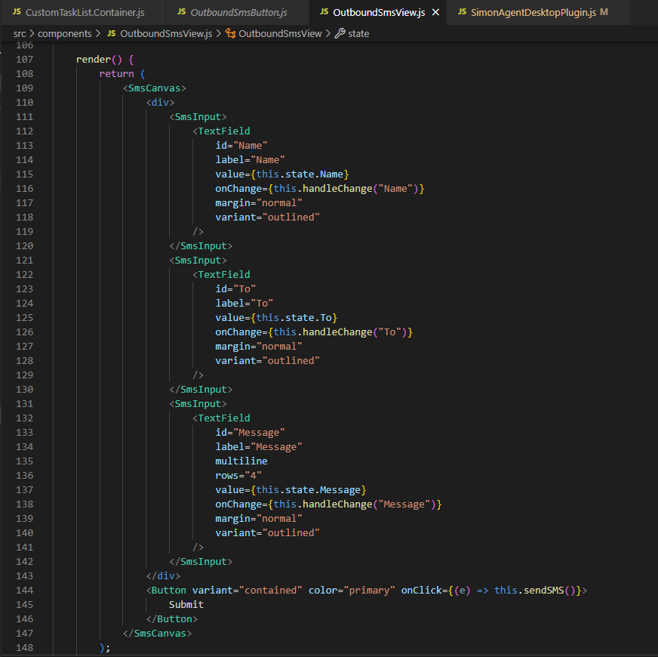
Twilio

Slide 7
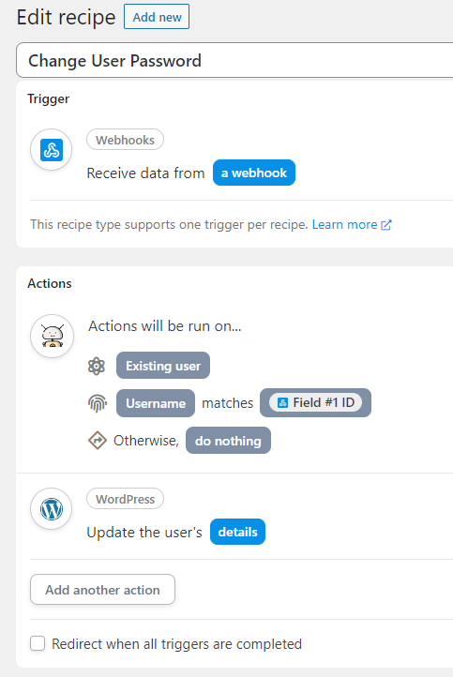
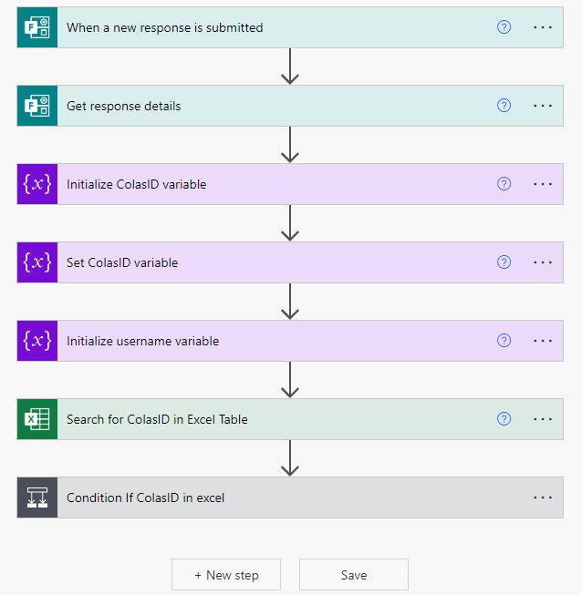
Reset Password

Slide 8
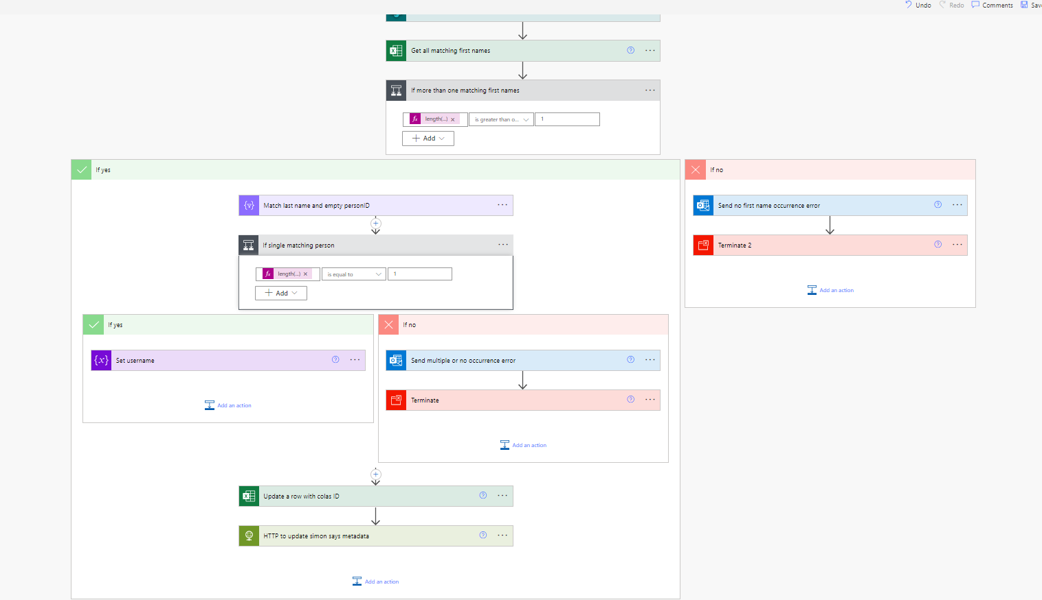
Colas ID

Slide 9
Good, Bad, Ugly
Good : Josh
Bad: Communication
Ugly: IT resources

Slide 10
Personal Goals/Takeaways
Get out of comfort zone
1
Get real world experience
2
Learn new technologies
3

Slide 11
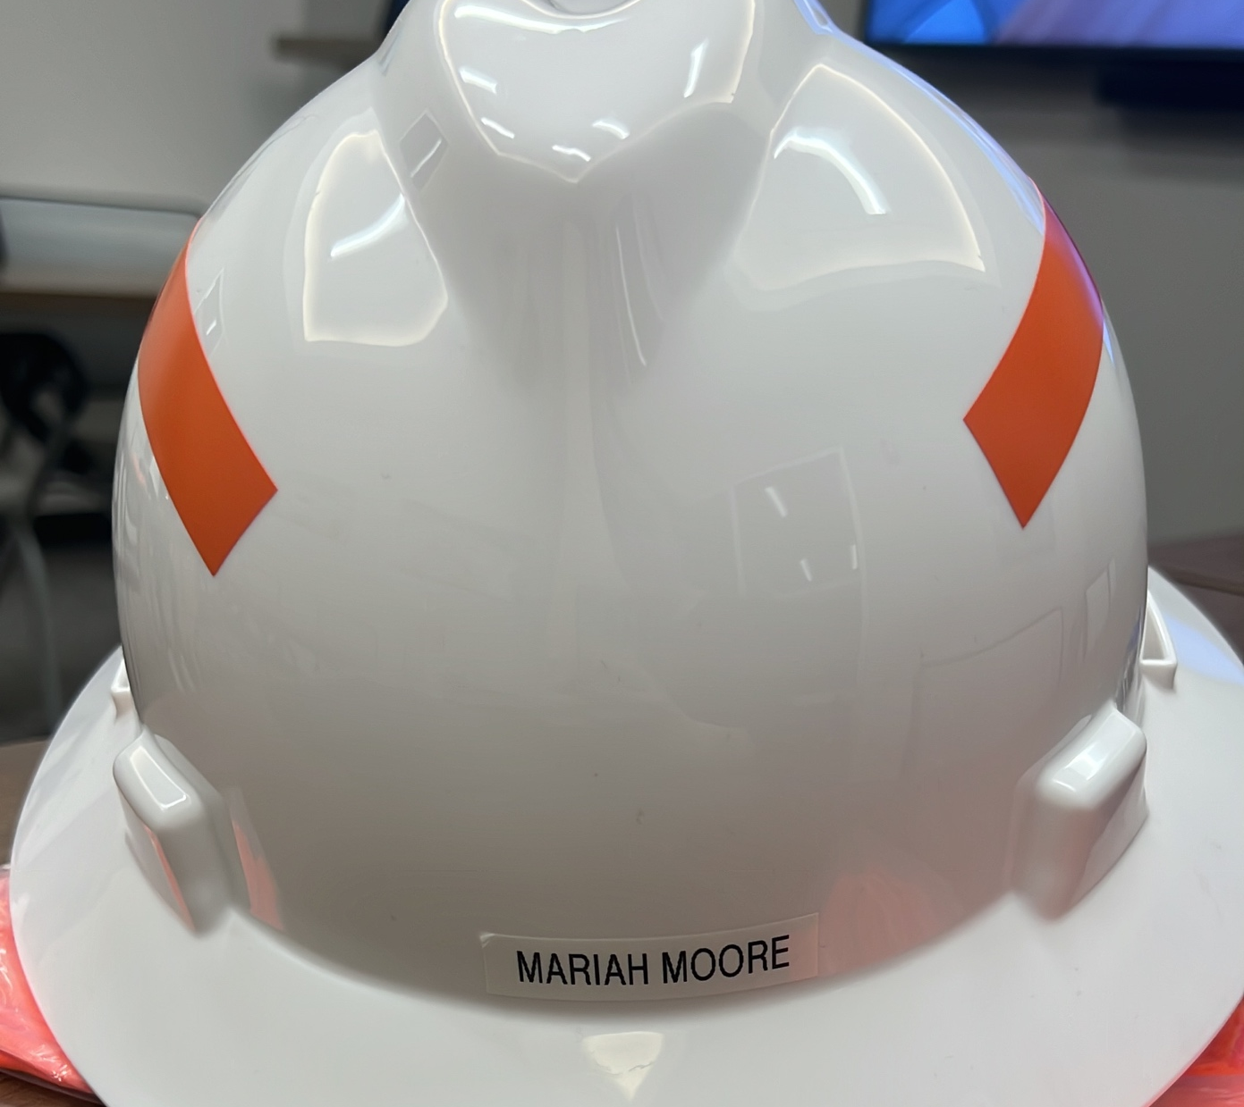
Simon Safety
Continue IT resources
Safety video for every site

Slide 12
Suggestions
Weekly intern meetings
Some activity every month

